Slide 1
MA OER Advisory Council
Marilyn Billings, Co-chair and
Head of Scholarly Communication at UMass Amherst

Slide 2
Who are we?
Notes:
Partner

Slide 3
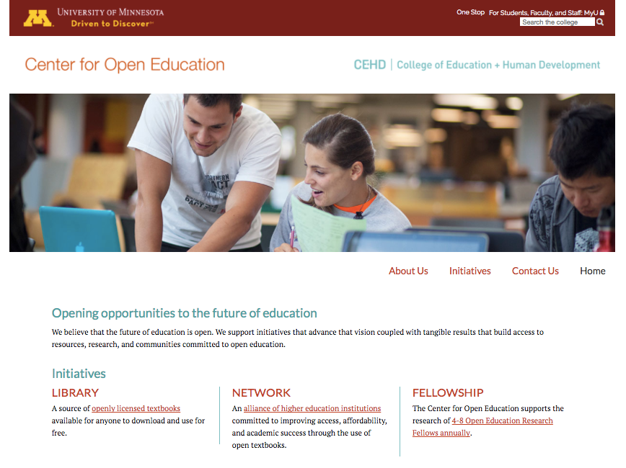
Notes:
Partner

Slide 4
Open Textbook Network
Notes:
Partner Today, that looks like 119 members, some of which are individual institutions, and some of which are statewide systems or consortia.
Together, we represent more than 1000 campuses.

Slide 5
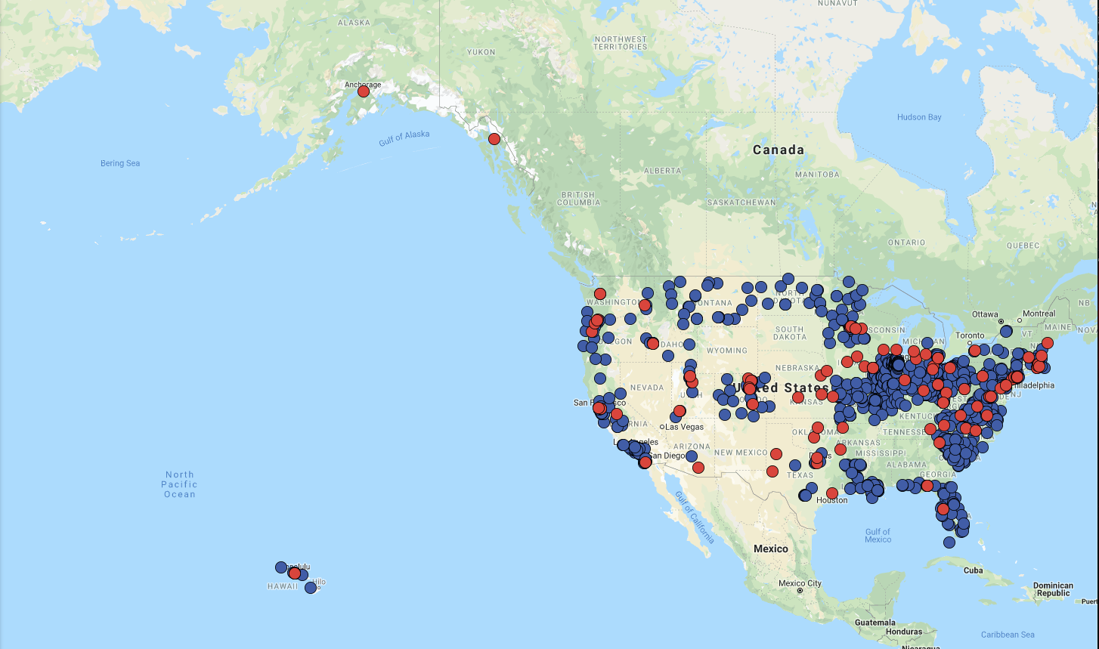
Notes:
Partner: Over 600 people trained
This gives you an idea of the span of our community, reaching states in every part of the country.
(Blue = consortia; red = institutional member)

Slide 6
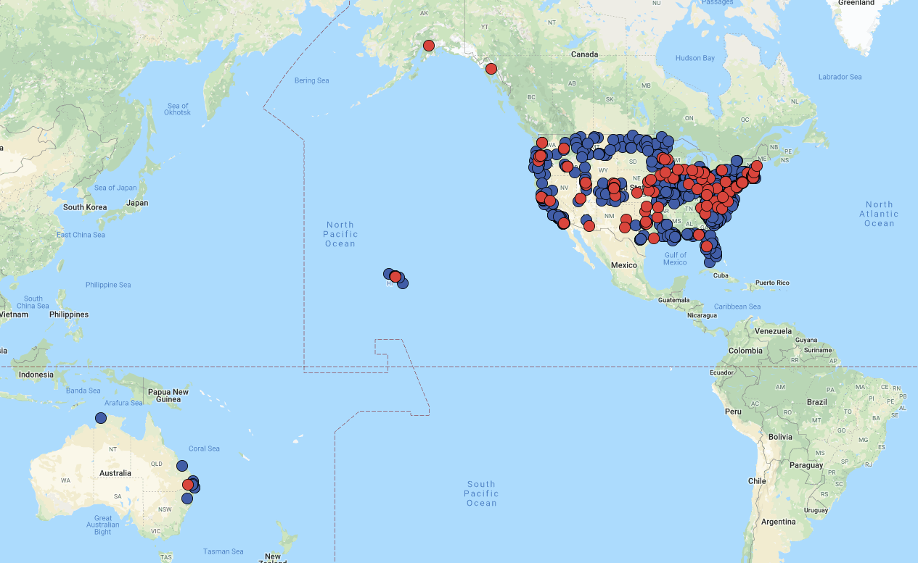
Notes:
And we extend beyond the US. We are also working with institutions in Australia to build open education programming there as well.

Slide 7
Our Focus: Open Education

Slide 8
open.umn.edu/opentextbooks
Notes:
The library launched in April, 2012, and it's been growing ever since. So far this year the Open Textbook Library has been visited more than 60,000 times a month. That's more than five times the visits just three years ago. There are other milestones, too. Recently we added the 1,000th textbook review.

Slide 9
Why Open?
Facilitates the free exchange of information.
Allows higher education to take ownership of its content.
Empowers faculty.
Sharing is scalable.
Notes:
Faculty member can manipulate, re-order content. They can make choices.
Materials for our courses can be shared with everyone. The OTL content is used around the globe.

Slide 10
“The Workshop” Strategy
A framework for engaging faculty
Open Textbook Library
Workshop
Review
Makes faculty aware that there are open textbook options for them to consider.
Helps faculty understand what open textbooks are and addresses misconceptions and concerns.
Gets faculty to take the time to engage with a textbook so they can see if it could work for them.

Slide 11
Open Textbook Review Criteria
Comprehensiveness
Content Accuracy
Relevance Longevity
Clarity
Consistency
Modularity
Organization Structure Flow
Interface
Grammatical Errors
Cultural Relevance
Notes:
This is the rubric that faculty members use. It was originally developed by BC Campus. Each faculty member receives an email from the OTN coordinator.
We don’t read or edit the reviews before they are posted. We’re taking whatever they tell us is good or bad.
Comprehensiveness: text covers all areas and ideas of subject appropriately and provides an effective index / glossary
Accuracy: error-free and unbiased.
Relevance longevity: up to date, necessary updates will be relatively easy to implement
Clarity: lucid, accessible prose and provides adequate context fo any jargon / technical terminology used.
Consistency: internally consistent in terms of terminology and framework
Modularity: easily and readily divisible into smaller reading sections that can be assigned at dif points within the course. Not overly self-referential, should be easily reorg’d and realigned with various subunits of a course without presenting much disruption to reader.
Flow: topics presented in a logical, clear fashion
Interface: text is free of sig interface issues (navigation, distortion of images / charts, or other display failures)
Grammar: no errors
Cultural relevance: not culturally insensitive or offensive in any way. Use examples that are inclusive of a variety of races, ethnicities, and backgrounds

Slide 12
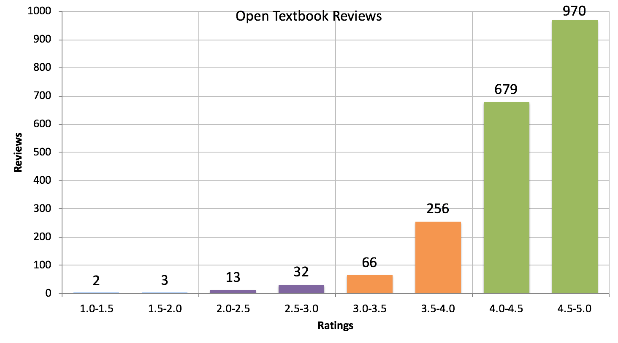

Slide 13
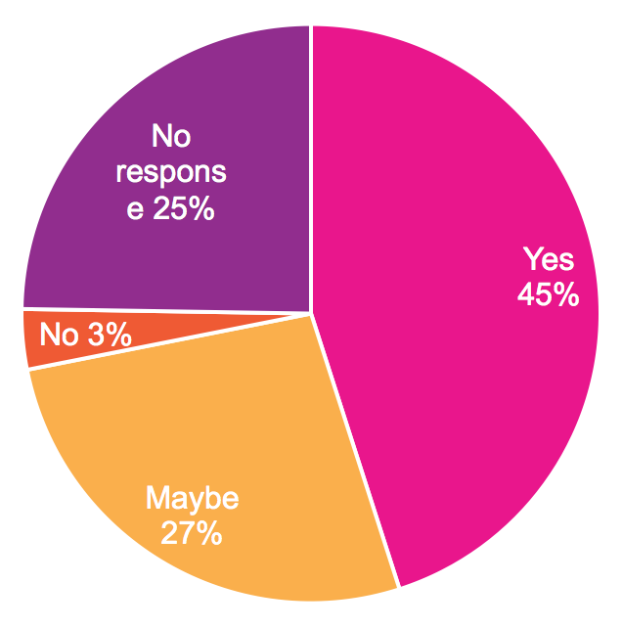
Faculty Adoption Decisions
250+ workshops
3250+ faculty
45% adopt

Slide 14
What does it mean to create
sustainable open education programs?

Slide 15
How might we support:
students
faculty
staff
campus-wide collaboration
securing funding
demonstrating impact
open educational practices
creation

Slide 16
Strategies
Best Practices
- Action-based - Adoption - Publishing
- Guides - Templates - Expertise
Community
Shared Solutions
Prof. Dev.
- OTL - Slides - Data collection
- Working groups - Mailing list - OTNSI
Notes:
We believe that the answer is in community.

Slide 17
Whatever barriers we face -
Notes:
Photo by Tim Collins on Unsplash

Slide 18
We face them together.
Notes:
You have this group, and the whole OTN, at your disposal to help you. You are not alone.
Google Group!!!
Photo by rawpixel.com on Unsplash

Slide 19
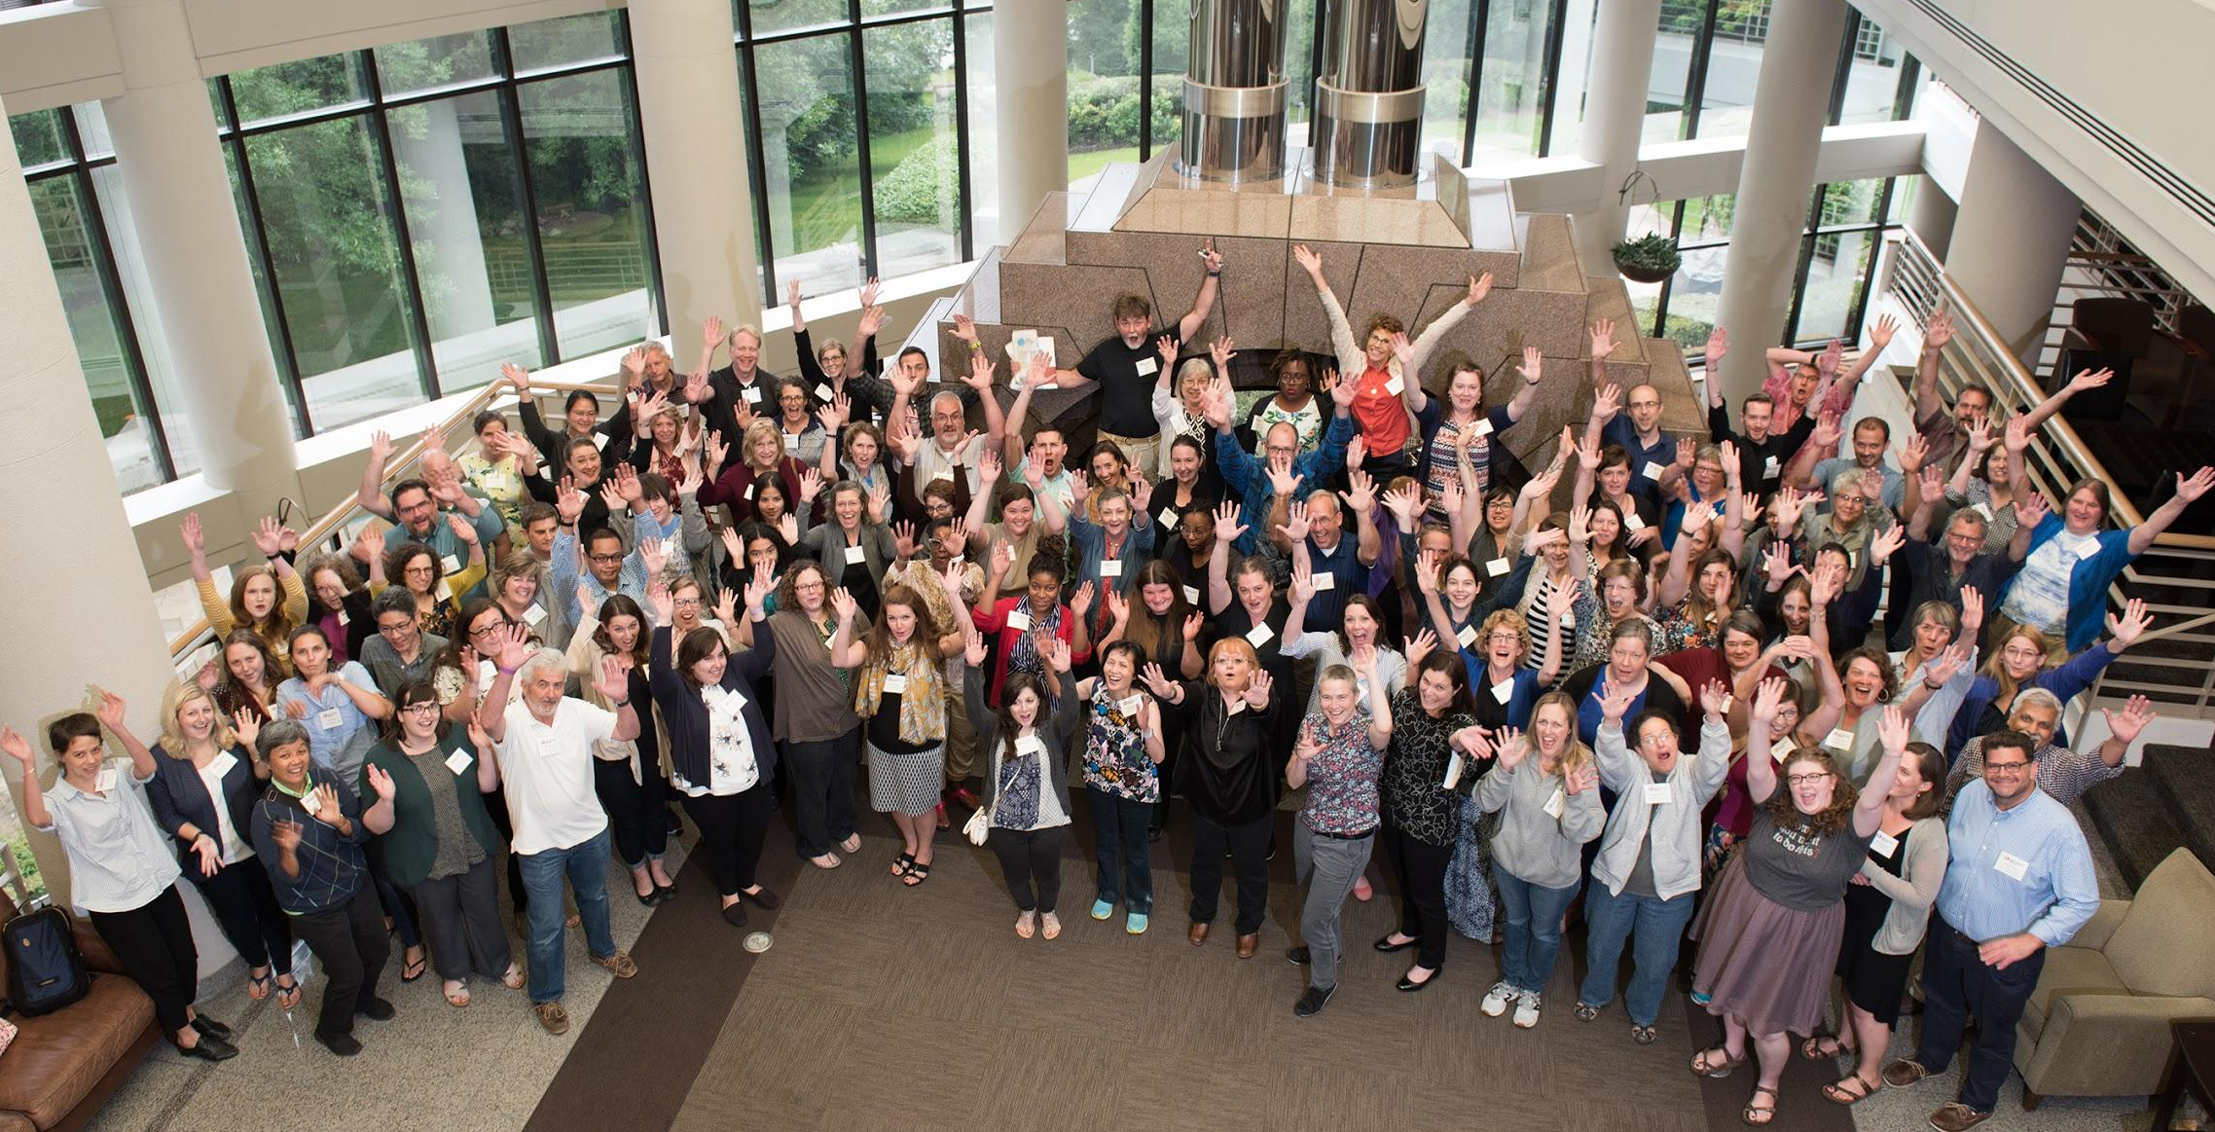
Notes:
OTN community describes itself as collaborative, engaged, supportive, welcoming, helpful, open, enthusiastic, inspiring.

Slide 20
MA DHE is OTN consortia member
OTN trainings and materials from March 18 and April 24
OTNSI attendance for 4 representatives
Individual campus reduced rate for membership = $500
Member of large community with impact statewide and beyond

Slide 21
THANK YOU
mbillings@library.umass.edu
@BillingsMarilyn
open.umn.edu

